Slide 1
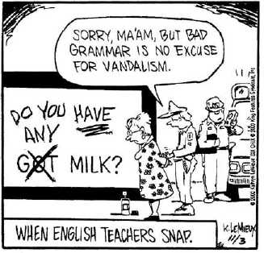
Sentence Fragments

Slide 2
Review: What makes a complete sentence?
Subject
What is the subject in each sentence?
Our teacher always buys some sanity on the way home.
The white mark around the black cat’s neck seemed to form into a noose.
Because she loved her sister, Isabelle took the slap for Ruth.

Slide 3
Review: What makes a sentence?
Predicate
What is the predicate in each subject?
We could not go to Silver Star Mountain this weekend because of avalanche danger.
I watched in horror as my dog consumed the entirety of my fallen sandwich.

Slide 4
Why use complete thoughts?
We write in complete sentences to communicate our ideas accurately.
Incomplete sentences—fragments—while popular with advertisers, have no place in school or work.
A well-written sentence leaves little room for the reader to misunderstand.

Slide 5
Why use complete thoughts?
Bob,
Can’t get this to work. Think it’s got something wrong with the alternator. Been a problem already. You remember. Can you fix this? Need it before the meeting next week.
Bart

Slide 6
Sentence Fragments
Sentence fragments are incomplete sentences.
So, based on your previous lessons, what can be missing from a sentence fragment.
1. ???
2. ???
3. ???

Slide 7
Sentence Fragments
Sometimes sentence fragments can have a subject, and a verb, but the thought is incomplete.
These sound obvious. However, we still see them a lot in writing.

Slide 8
Fragment Type 1: Dependent Clauses
A dependent clause, or subordinate, cannot stand by itself as a sentence.
Even though a dependent clause my have a subject and a verb, the meaning is incomplete.
Examples: Before we went on to the next project.
If the road is too icy for traffic.

Slide 9
Which is the sentence, and which is the fragment?
I left an hour later than normal.
If I left an hour earlier than normal.
When our group finished its report.
Our group finished its report.
Whenever Rita tried to explain herself.
Rita tried to explain herself.

Slide 10
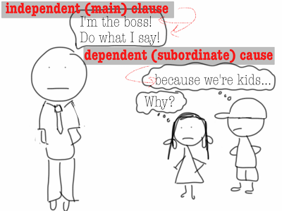
Fragment Type 2: Subordinate Conjunctions
If we look at our previous sample sentences, what are some differences between the dependent and independent clauses?

Slide 11
Fragment Type 2: Subordinate Conjuctions
These “extra” words in our dependent clauses are called subordinate conjunctions.
They modify a dependent, or subordinate, clause in some way.

Slide 12
Fragment Type 2: Subordinate Conjuctions
If a group of words that would normally be a complete sentence is preceded by a subordinate conjunction, something more is needed to complete the thought.
If I left an hour later than normal, I missed my favorite talk show. That is what I really do with my free time.
Whenever Rita tried to explain herself, she confused her words and just babbled incoherently.

Slide 13
Subordinate Conjuctions
Here are some subordinate conjunctions:
after although though where
if once unless while
as because since until
while than before that
whenever

Slide 14
Practice Together
Combine these fragments to make a REAL sentence.
Emily sat on the sofa. Wondering what to do next.
Descending from the sky. We saw aliens.

Slide 15
MORE Subordinate Conjuctions
Sometimes a subordinate conjunction is a phrase rather than a single word:
As if…
As though…
As long as…
As soon as…
Even though…
In order that…
So that…

Slide 16
PHRASES as Sentence Fragments
Dependent clauses are only one type of sentence fragment.
A phrase is a group of words that does not contain a subject or a predicate and does not complete a thought

Slide 17
PHRASES as Sentence Fragments
The class was ready for the next step.
Talking to the poltergeist.
Watching the sky.
The picnickers saw the aliens descend.
Alone for the first time in a year.
I was comforted by the fact that I had stolen my mother’s ladder.

Slide 18
PHRASES as Sentence Fragments
In the previous sentences, combining the two sets of words will make one complete sentence.
With some of the word pairs, only a comma is needed.
With others, a few extra words must be added to incorporate the phrases into the rest of the sentence.

Slide 19
PHRASES as Sentence Fragments—Combine
The class was ready for the next step.
Talking to the poltergeist.
Watching the sky.
The picnickers saw the aliens descend.
Alone for the first time in a year.
I was comforted by the fact that I had stolen my mother’s ladder.

Slide 20
Practice
#1-5

Slide 21
Separated Fragments
Sometimes a fragment is part of a complete sentence, but is written as a separate sentence.
Which of the following word groups expresses a complete thought?

Slide 22
Separated Fragments
The Blazer fans drove all over the Rose Quarter.
And looked for a parking spot.
Faulty equipment and poor workmanship.
They refused to pay the bill in full.
In the water garden outside our school.
Canada geese have built a nest.

Slide 23
Separated Fragments
The Blazer fans drove all over the Rose Quarter.
And looked for a parking spot.
Faulty equipment and poor workmanship.
They refused to pay the bill in full.
In the water garden outside our school.
Canada geese have built a nest.

Slide 24
Combined Sentences
There is more than one way to combine the sentences (and skin a cat), but here are some examples:
The fans drove all over the Rose Quarter and looked for a parking spot.
They refused to pay the bill because of faulty equipment and poor workmanship.
In the water garden outside our school, Canada geese have built a nest.

Slide 25
Practice
#6-10

