Slide 1
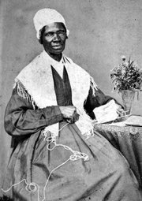

Chapter 18 An Era of Reform
Introduction
Between 1820 and 1850 American reformers devoted themselves to ending slavery, promoting women’s rights, and improving education
Sojourner Truth was an effective reformer especially with her speech “And ain’t I a woman”.

Slide 2
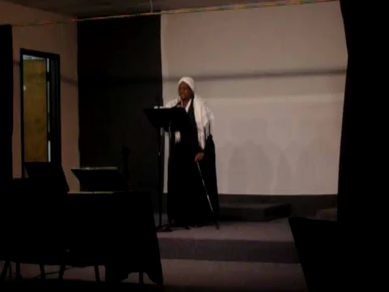
Ain’t I a Woman

Slide 3
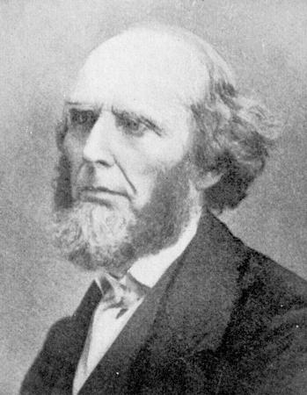
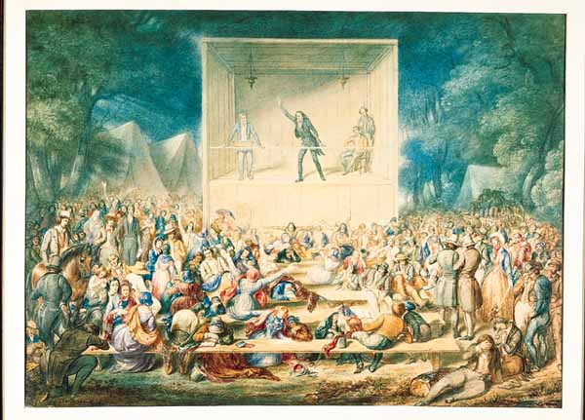
18.2 The Spirit of Reform
New religious movements played a key role in inspiring Americans to remake society
The Second Great Awakening was a religious revival in the 1820s and 1830s
Leader of the movement was Charles G. Finney
The revival fired people’s emotions
Preachers told people that they could gain
forgiveness and be saved by doing good works
* It gave men and women a reason to work for the improvement of society

Slide 4
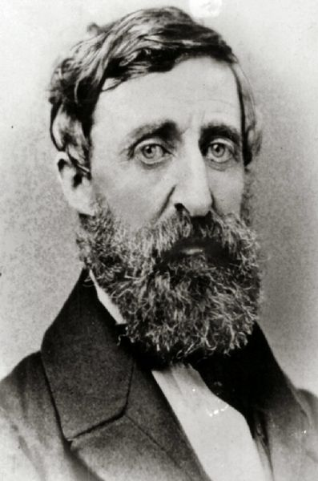
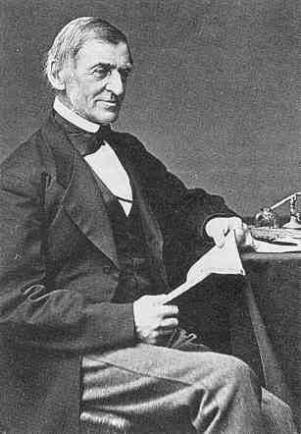

18.2 Optimistic Ideas
Ralph Waldo Emerson was a central figure in a movement called transcendentalism
Said people had to “transcend” or go beyond logical thinking and find answers to life’s mysteries by learning to trust their emotions and intuition (felt people were basically good and would do the right thing)
Urged people to question society’s rules and institutions
Henry David Thoreau (Emerson’s friend) spent 2 years in solitude to learn to be without rules of society
Ralph Waldo Emerson
Henry David Thoreau

Slide 5
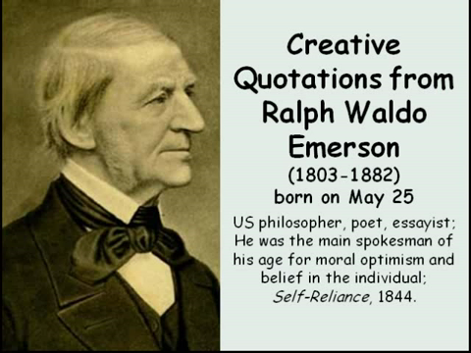
Quotations from Emerson

Slide 6

Biography of Thoreau

Slide 7
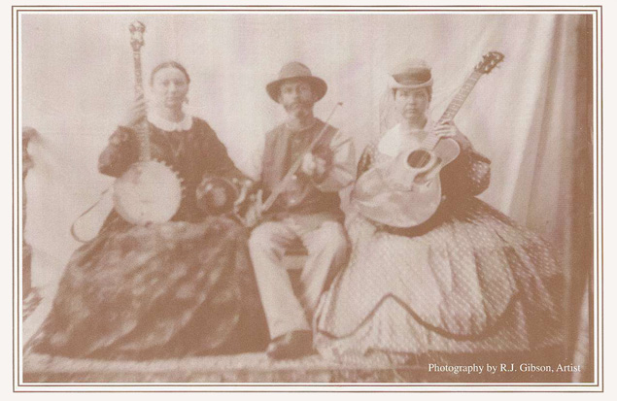
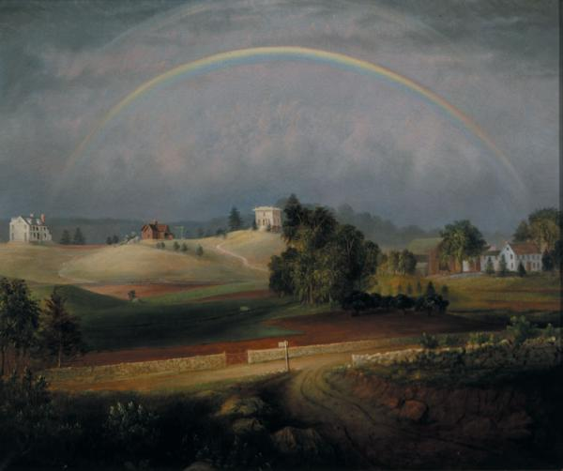
18.2 Model Communities
Brook Farm was an experiment in creating a perfect community
Residents shared the labor of supporting themselves by farming, teaching, and making clothes
Most of these communities lasted only a few years
They did symbolize the belief that people of good will could create an ideal society
Brook Farm String Quartet
Brook Farm

Slide 8
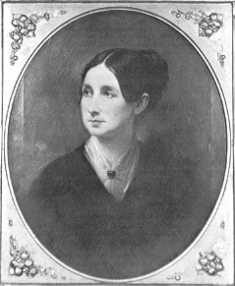

18.3 Reforming the Treatment of Prisoners and the Mentally Ill
Dorothea Dix was instrumental in reforming conditions of prisoners
Saw inmates bound in chains and locked in cages
Children were jailed with adult criminals
Dix visited jails, prisons, and hospitals to witness conditions

Slide 9
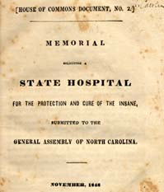
18.3 Plight of the Mentally Ill and Campaigning for Better Conditions
Dix was shocked at the way mentally ill were treated
Believed that the mentally ill needed treatment and care, not punishment
Dix prepared a report for the Massachusetts state legislature
Lawmakers voted to create public asylums
Dix campaigned for the rest of her life
By 1887 debtors were no longer put in prison; special justice systems were created for children in trouble; and cruel punishment was outlawed

Slide 10
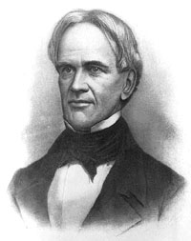
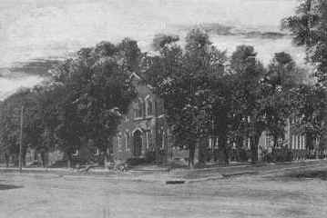
18.4 Improving Education
Next reform movement was to make education available to more children
Led by Horace Mann “the father of American public schools”

Slide 11
18.4 Need for Public Schools
Puritans established town schools
A few areas had public schools
Wealthy parents sent their children to private schools
Most children simply didn’t go to school at all
Reformers believed education would help children in cities escape poverty and become good citizens
New York was first state to make public schools in every town
Massachusetts voted to pay taxes to build better schools, pay teachers higher salaries, and establish training school for teachers

Slide 12
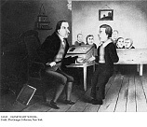
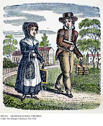
18.4 An Unfinished Reform
By 1850, most white children, ESPECIALLY BOYS, attended free public schools
Most high schools and colleges didn’t admit women
Most blacks were kept out of public schools
Blacks were made to go to separate
schools that received less to no money
Horace Mann encouraged students to
become involved in improving society:
“Be ashamed to die until you have won
some victory for humanity”

Slide 13

18.5 Fighting Slavery
If America was the land of the free, how could it allow slavery?
People who wanted to end slavery were called abolitionist
By 1792, majority of states had anti-slavery societies
Slave trade ended in 1808
Northern shipping communities didn’t have any more interest in slaves but liked the cheap cotton that the south provided using slave labor
Disagreement on how to end slavery:
a. radicals: inspire slaves to rise up in revolt
b. pacifists: find a peaceful solution immediately
c. moderates: give slaveholders time to develop new farming methods that didn’t need slaves
In 1831, William Lloyd Garrison started an abolitionist newspaper the Liberator
Said “I will be as harsh as truth”

Slide 14
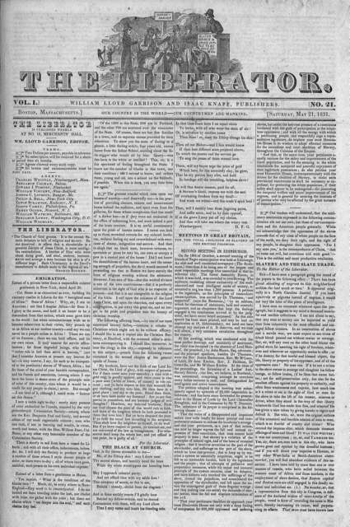
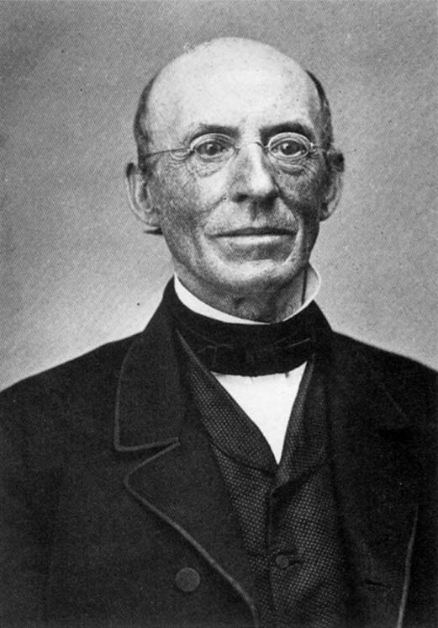
William Lloyd Garrison

Slide 15
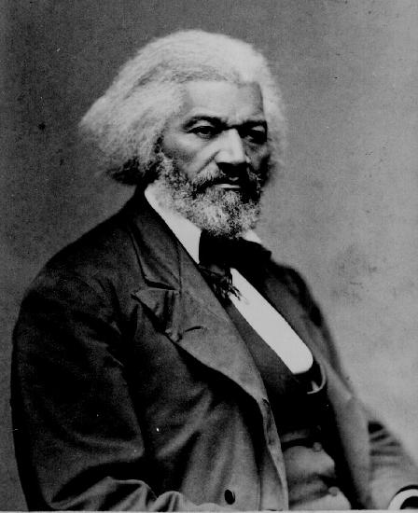
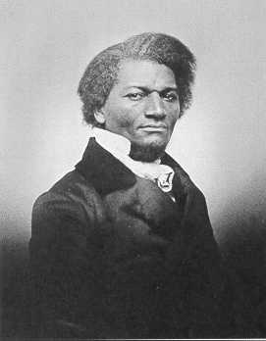
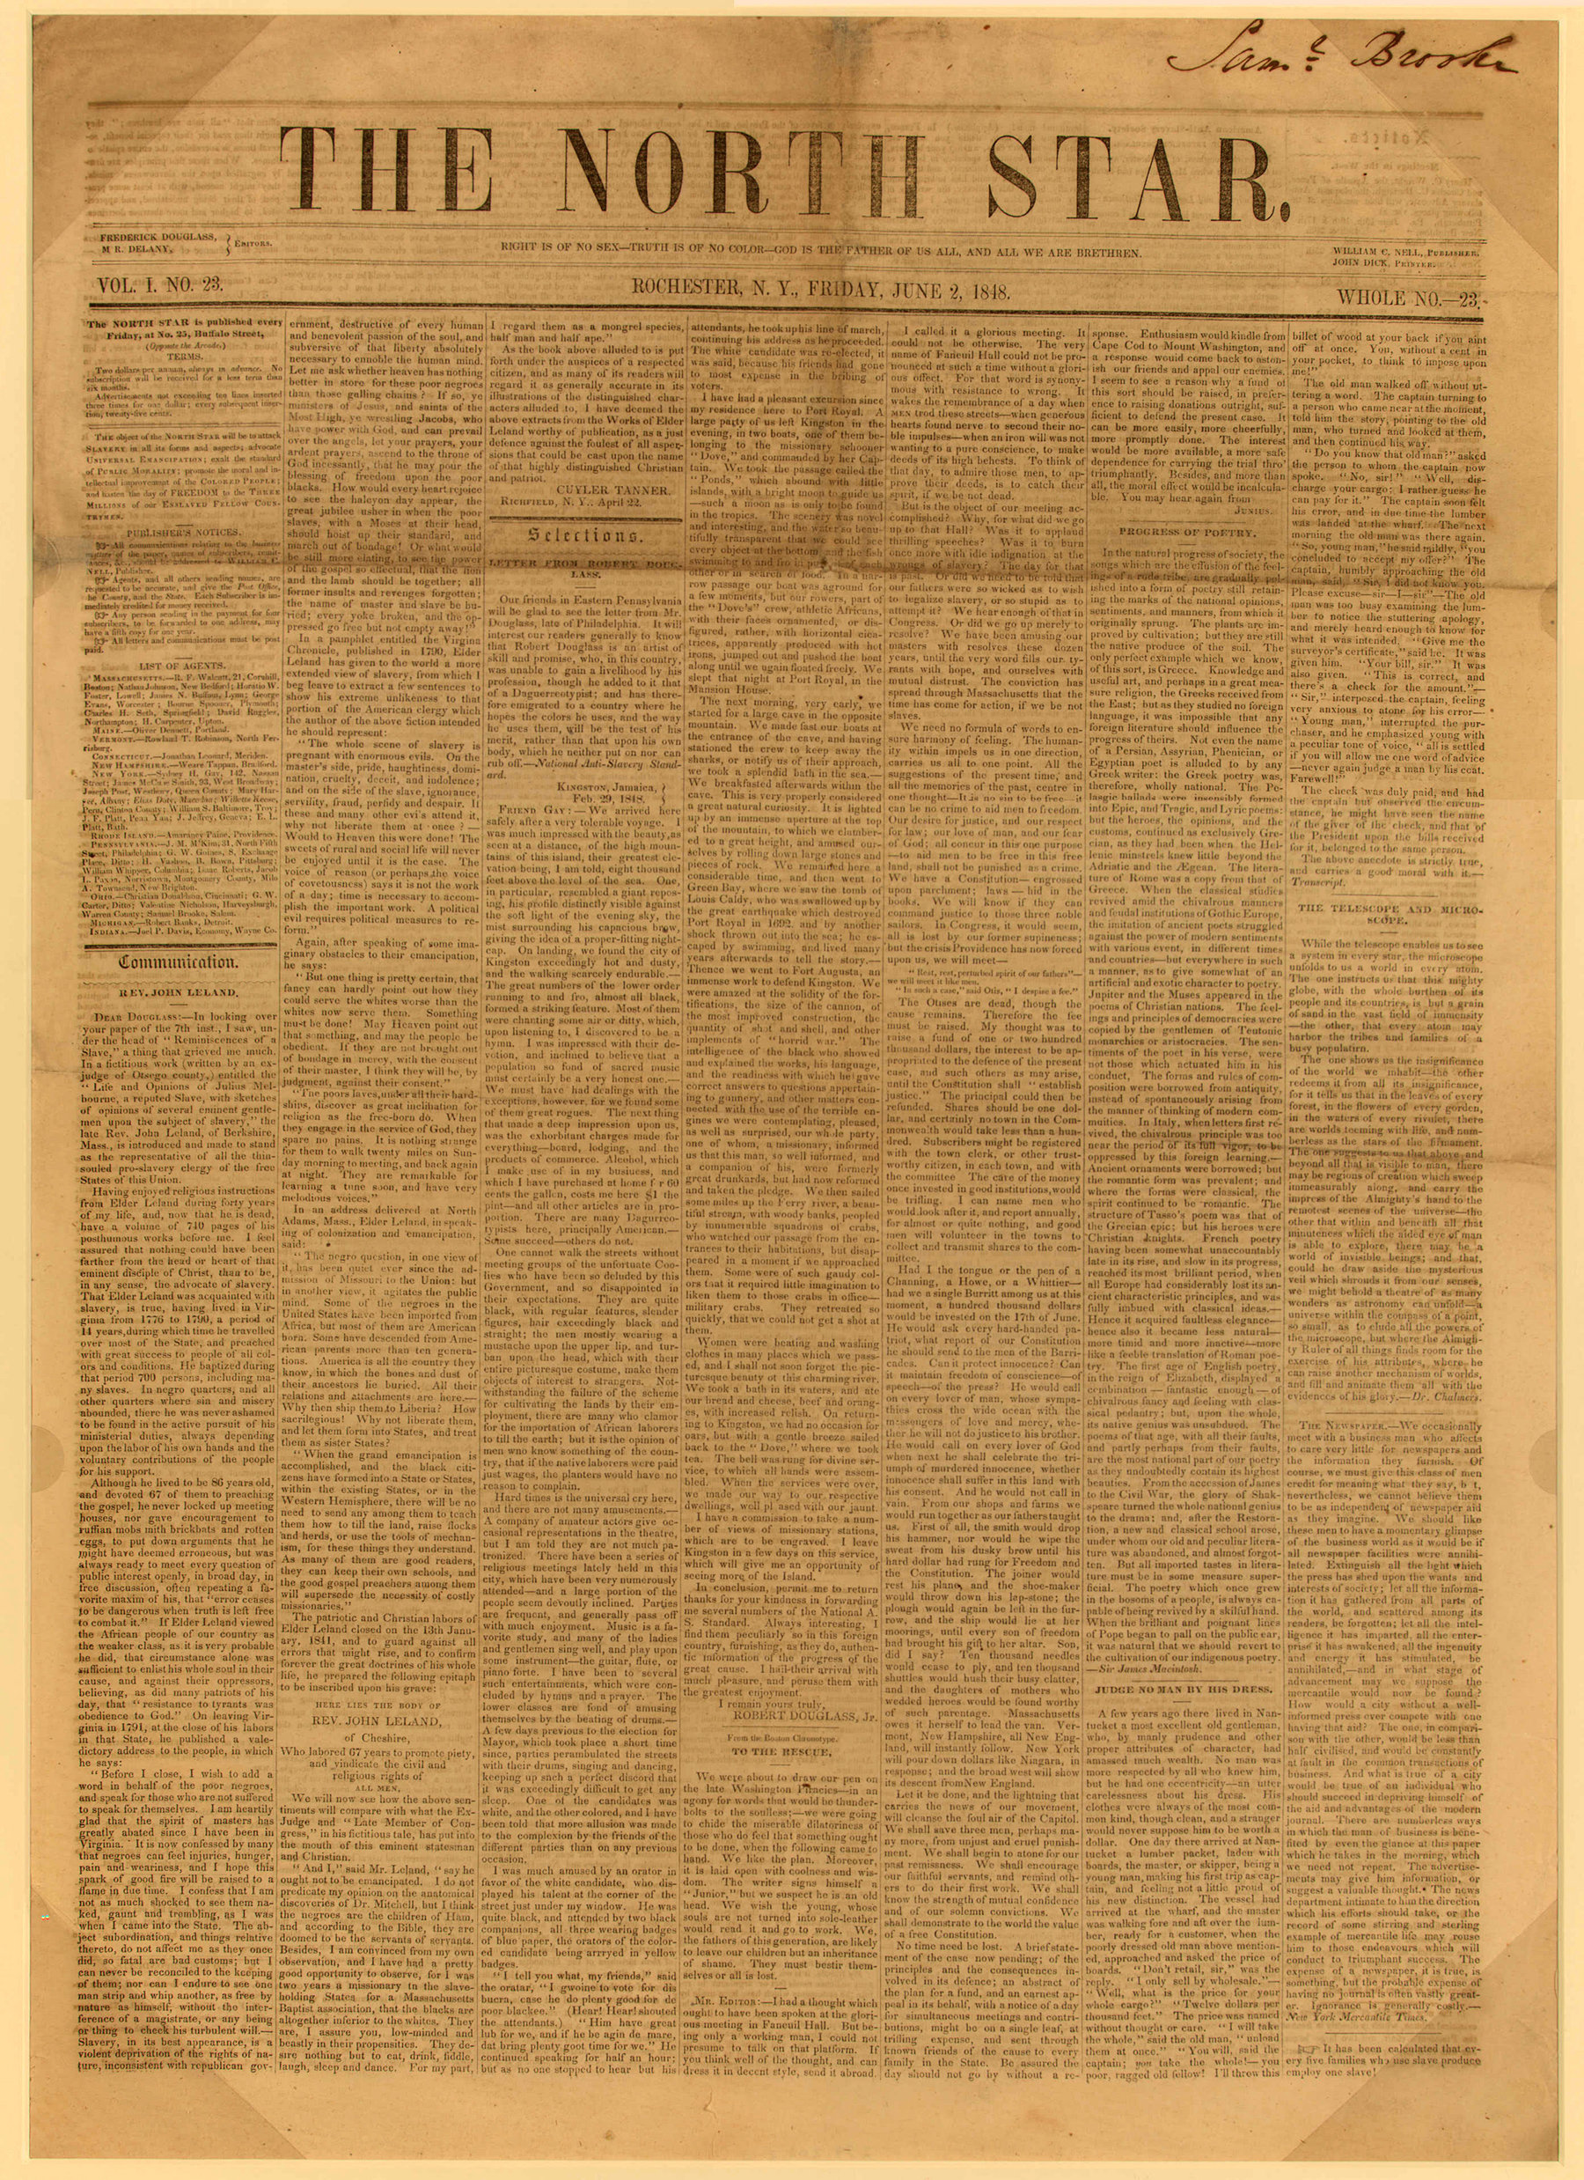
18.5 Frederick Douglass Speaks Out
Douglass became a leader in the abolitionists movement
Started a newspaper the North Star
Newspaper’s motto was “Right is of no sex – truth is of no color – God is the father of us all, and we are all Brethren.”

Slide 16

Biography of Douglass

Slide 17
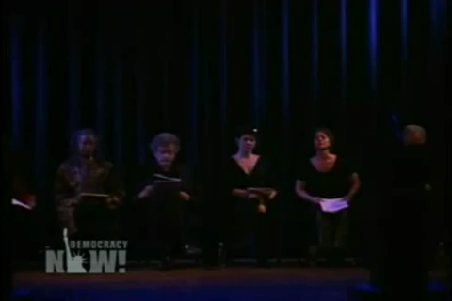
James Earl Jones reads Frederick Douglass

Slide 18
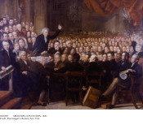
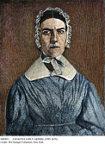
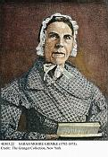
18.5 Women Get Involved
Angela and Sarah Grimke spoke out about the poverty and pain of slavery
They led the way for other women to speak in public
Sarah Grimke
Angelina Grimke
Abolitionist meeting

Slide 19

Grimke Sisters

Slide 20
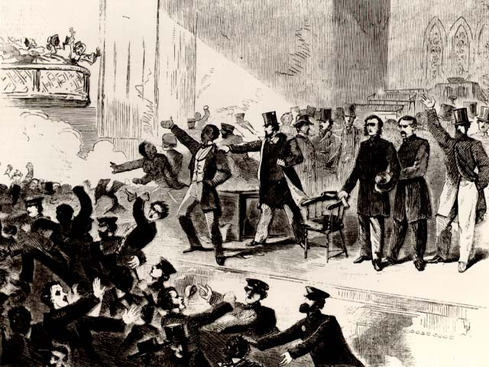
18.5 Women Get Involved
Sojourner Truth, a former slave, was an abolitionist
She argued that God would end slavery peacefully
Abolitionists were a minority and there was violence directed toward them
The violence helped change northerner’s attitude toward slavery
Women’s anti-slavery fight started the next reform movement for women’s rights
Sojourner Truth
Abolitionist meeting turned violent

Slide 21
Sojourner Truth

Slide 22

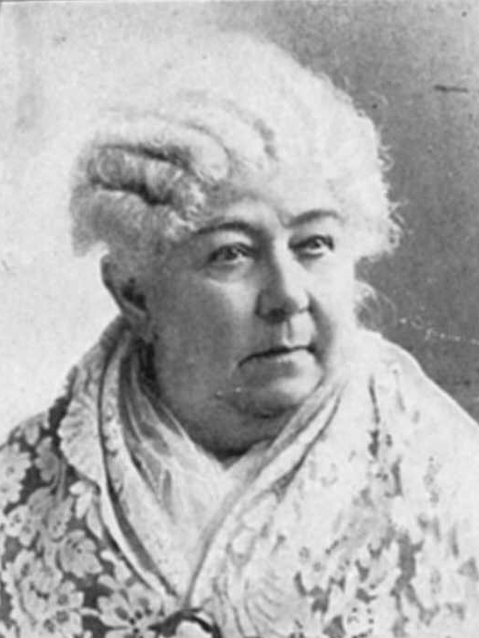
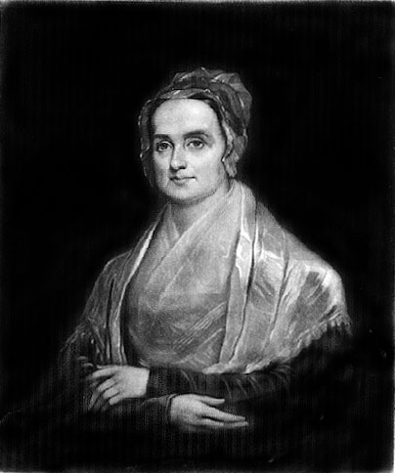
18.6 Equal Rights for Women
Women abolitionists tried to convince lawmakers to make slavery illegal but they couldn’t vote or hold office
Women’s money and property were controlled by fathers and husbands
Husbands could discipline wives whenever they wanted
Struggle for women’s rights began with Lucretia Mott and Elizabeth Cady Stanton
Lucretia Mott
Elizabeth Cady Stanton

Slide 23
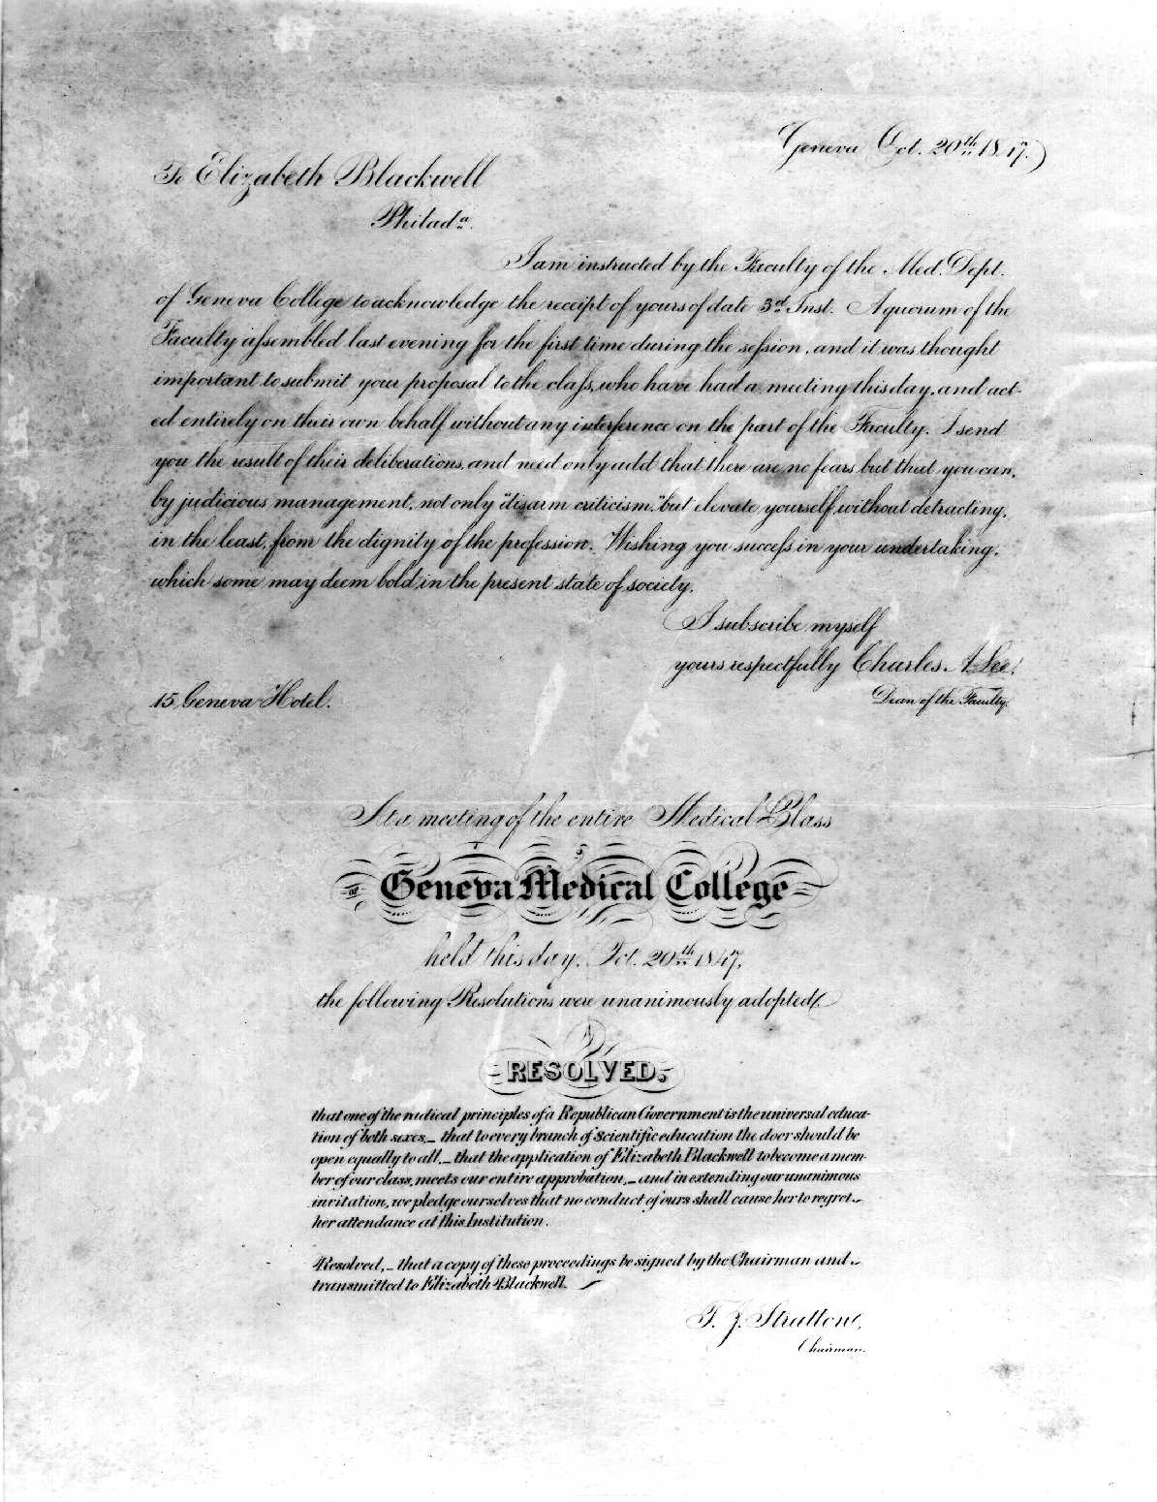
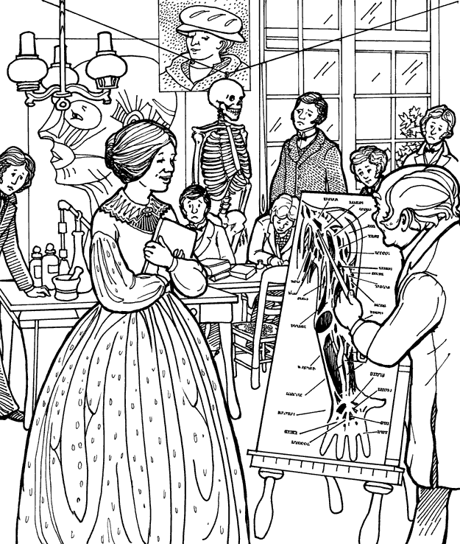
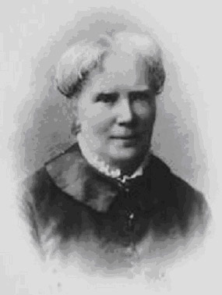
18.6 Unequal Treatment of Women
Lucy Stone refused to pay property taxes because she said women had no representation
Elizabeth Blackwell wanted to be a doctor but no medical school would allow her
She was finally accepted and became the first female doctor
Medical degree
Elizabeth Blackwell

Slide 24
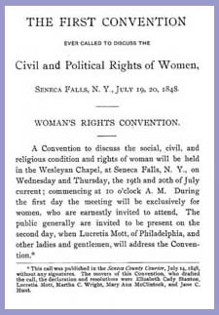
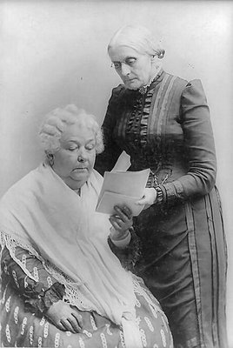
18.7 The Seneca Falls Convention and the Declaration of Sentiments
Lucretia Mott announced a women’s convention in Seneca Falls, New York
The convention started on July 19, 1848
Abolitionists, Quakers, local housewives, farmers, and factory workers attended
Wrote up a proposal called the Declaration of Sentiments based on the Declaration of Independence
“We hold these truths to be self-evident that all men and women are created equal”
Cady and Stanton
Declaration of Sentiments
Lucretia Mott

Slide 25

Women’s Suffrage

Slide 26
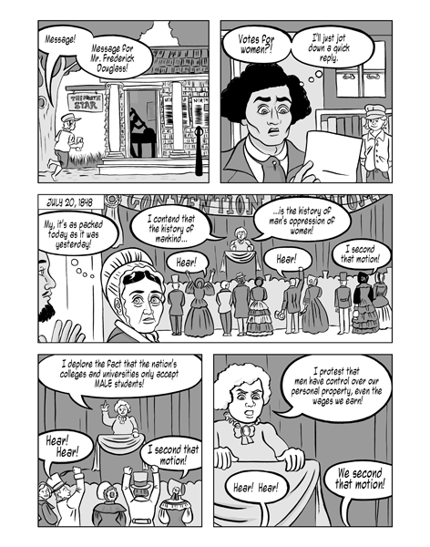
18.7 Legacy of Seneca Falls
Convention voted to approve the
idea that women should have the
right to vote
The Convention helped to create
an organized campaign for women’s
rights
Susan B. Anthony traveled from
town to town speaking for women’s
rights
Reformers for women’s rights
made progress
New York gave women control
over their property and wages
Some states passed more liberal
divorce laws
Blackwell started her own hospital
to train female doctors

