Slide 1
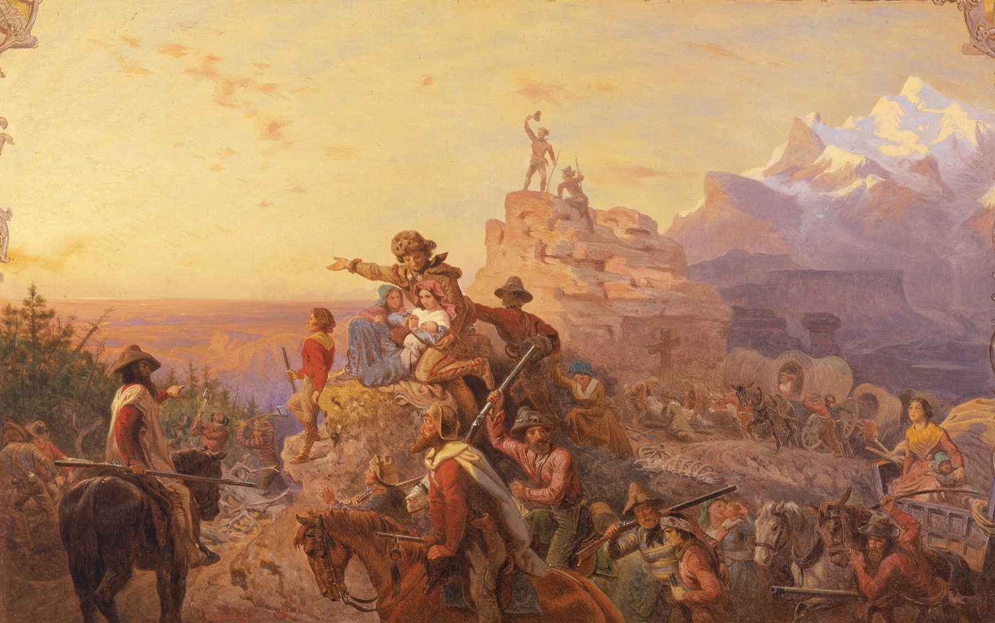
Ch. 16: Life in the West

Slide 2
Objectives:
By the end of this PowerPoint, students should be able to
List the reasons that explorers, Californios, mountain men, missionaries, pioneer women, Mormons, forty-niners, and Chinese moved to the West.
List the hardships that they endured.
Describe the legacies that they left to the West.

Slide 3
Eight Major Groups Moved to the West
16.2 The Explorers (pg. 212-213)
16.3 The Californios (pg. 216-217)
16.4 The Mountain Men (pg. 217-218)
16.5 The Missionaries (pg. 219-220)
16.6 The Pioneer Women (pg. 220-222)
16.7 The Forty-Niners (pg. 224-225)
16.8 The Mormons (pg. 222-223)
16.9 The Chinese (pg. 225-226)

Slide 4
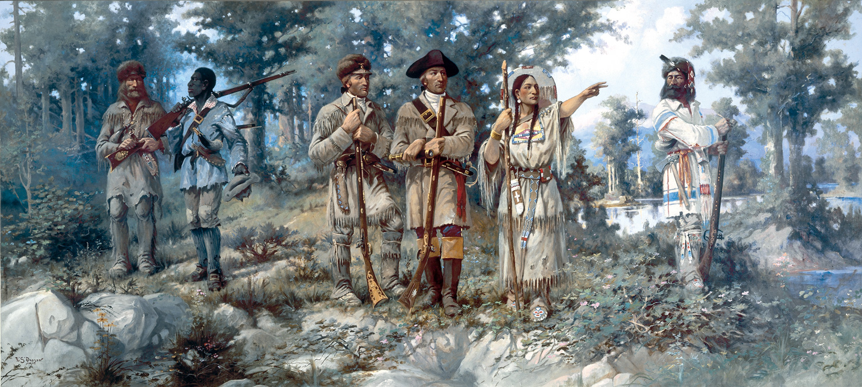
The Explorers

Slide 5
16.2 The Explorers
Reasons they moved to the West
They wanted to begin trade with Indian people.
They hoped to find the Northwest Passage.
They wanted to find out what the U.S. had bought when it purchased Louisiana.
Hardships they faced
Rowing against the current caused blistered hands and sore muscles.
They were bothered by mosquitoes and grizzly bears.
Prickly-pear cactus thorns pierced their feet.
Starvation was an ever-present danger.
Legacies they left
The explorers mapped the route to the Pacific.
They established good relations with western Indian peoples.
They brought back information about the West.

Slide 6
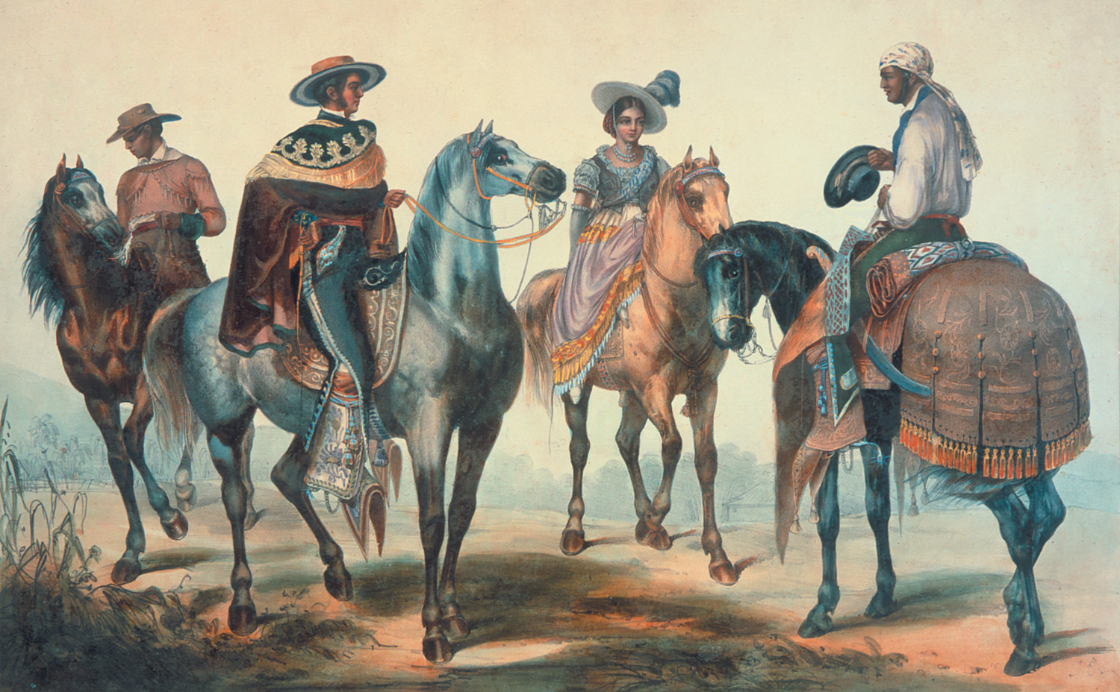
The Californios

Slide 7
16.3 The Californios
Reasons they moved to the West
Spanish priests went to establish missions.
Other Spanish settlers wanted to find land for settlement.
Hardships they faced
Neighbors lived so far apart that loneliness was a daily problem.
Government officials were unskilled and dishonest.
Legacies they left
The Californios gave us Spanish names for California cities.
They brought new crops, such as grapes, olives, and citrus.
They opened California to the world.

Slide 8
The Mountain Men

Slide 9
16.4 The Mountain Men
Reasons they moved to the West
The trappers went to search for furs.
Hardships they faced
The mountain men feared attack by fur thieves, Indians, wolves, and bears.
Death from accident or disease was a hazard of the profession.
Legacies they left
The mountain men explored the West.
Their routes became the Oregon and California Trails.
Their trading posts became supply stations for settlers.
Their personal journals make entertaining reading.

Slide 10
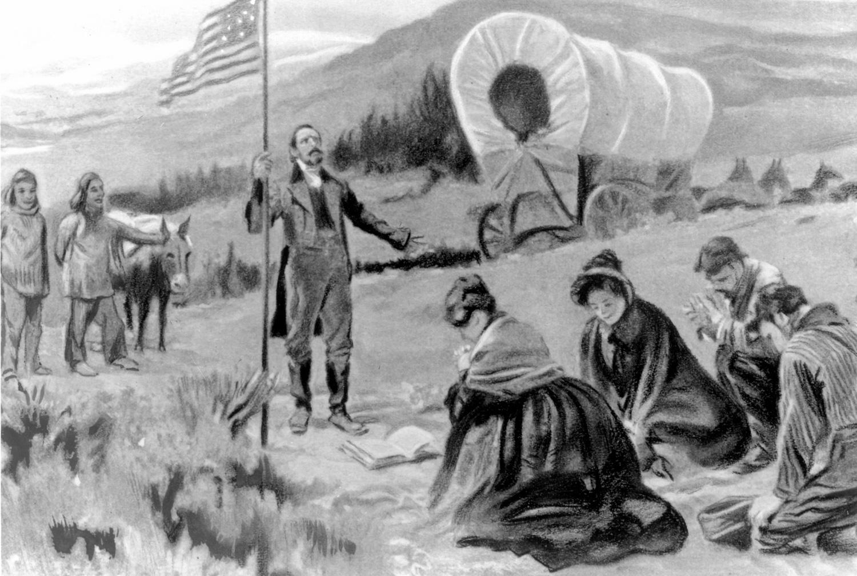
The Missionaries

Slide 11
16.5 The Missionaries
Reasons they moved to the West
The missionaries intended to convert Native Americans to Christianity.
They also wanted to help settle the country and establish churches.
Hardships they faced
Crossing the steep Rocky Mountains in wagons was difficult.
Hostile Indian warriors sometimes attacked them.
Legacies they left
These settlers brought disease and death to many Native Americans.
They opened the West to settlement.

Slide 12
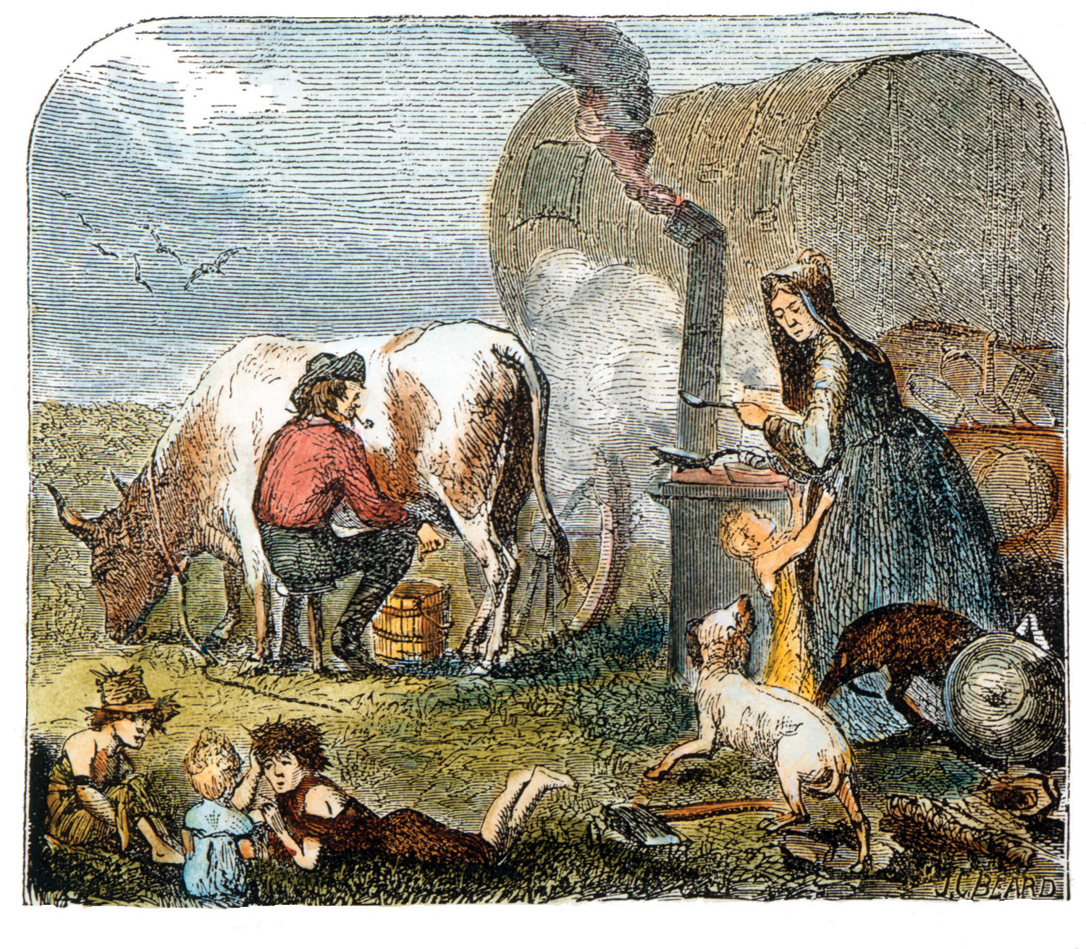
The Pioneer Women

Slide 13
16.6 The Pioneer Women
Reasons they moved to the West
Women moved west to find new opportunities, such as establishing homesteads and finding husbands.
Hardships they faced
Leaving the comforts of home and leaving treasured items along the trail was emotionally difficult.
Cooking, washing clothes, and caring for children while traveling 15 to 20 miles a day was grueling work.
Disease and accidents killed their loved ones.
Along the trail, they suffered from cold and thirst.
Legacies they left
Women brought schools, churches, libraries, literary societies, and charitable groups to the rugged west.
They fought for and won the right for women to vote in the West.

Slide 14
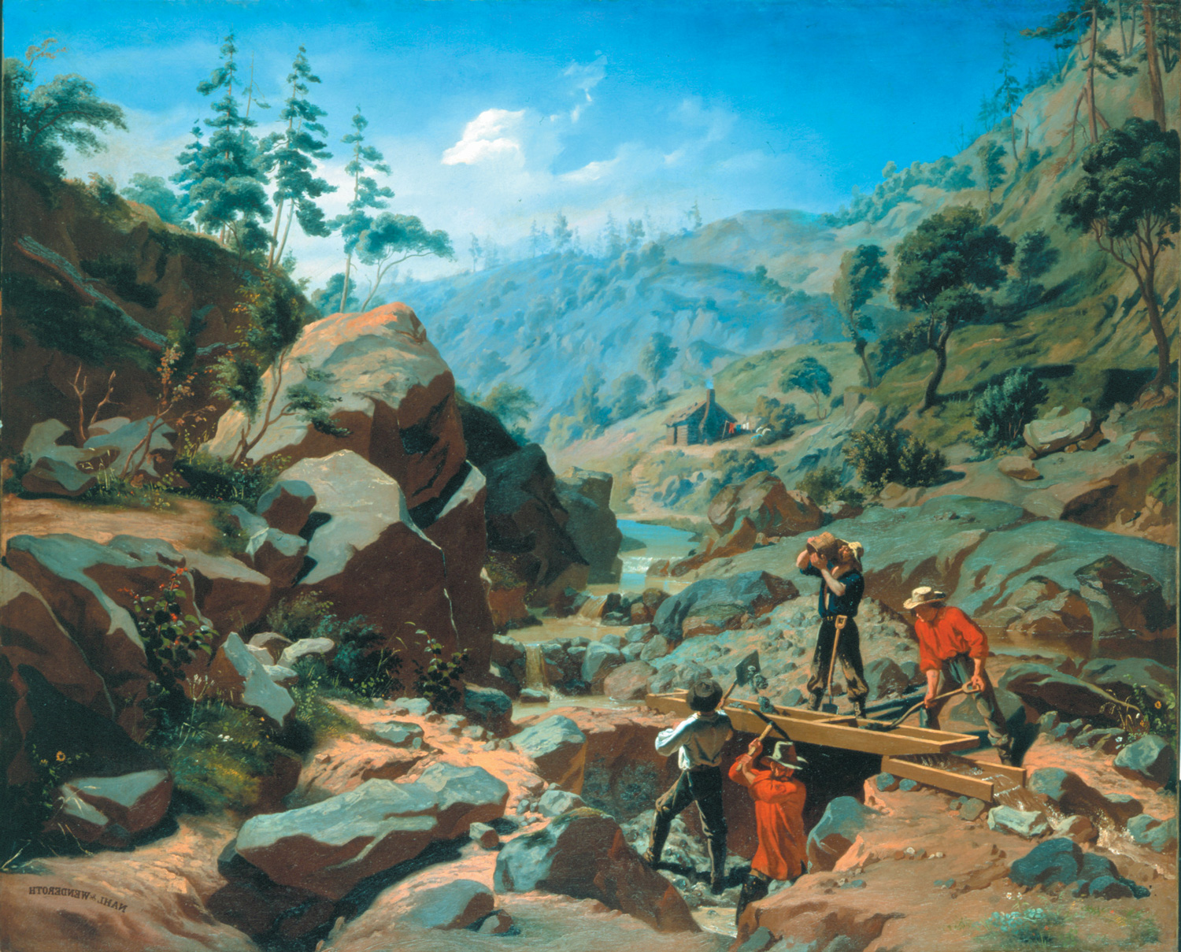
The Forty-Niners

Slide 15
16.7 The Forty-Niners
Reasons they moved to the West
The forty-niners hurried west to find gold.
Hardships they faced
They had a difficult journey to California, by either land or sea.
High prices made it hard to get ahead.
There were no police to keep order, so camps were rough and dangerous.
Gold mining was hard, tedious work.
Legacies they left
Warfare and disease reduced the Native American population.
Many Californios lost their land to these newcomers.
Their arrival increased the population of California so that it could become a state.

Slide 16
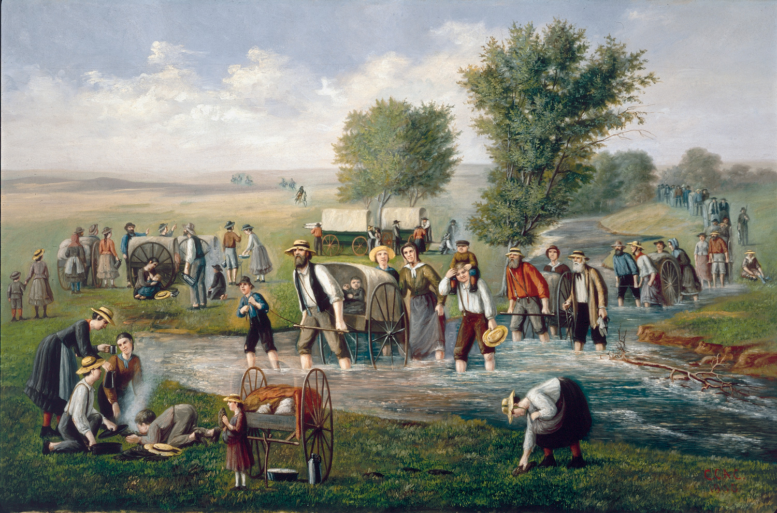
The Mormons

Slide 17
16.8 The Mormons
Reasons they moved to the West
The Mormons moved west to escape persecution back east.
Hardships they faced
Their road was a difficult journey with many deaths.
Life in a dry, barren land was difficult for these farmers.
Legacies they left
Mormons were the first pioneers to settle in the Great Basin.
They pioneered farming methods such as dams, canals, and irrigation ditches.
They helped other settlers make their way west.
In Utah, they established a center for what is now a worldwide religion.

Slide 18
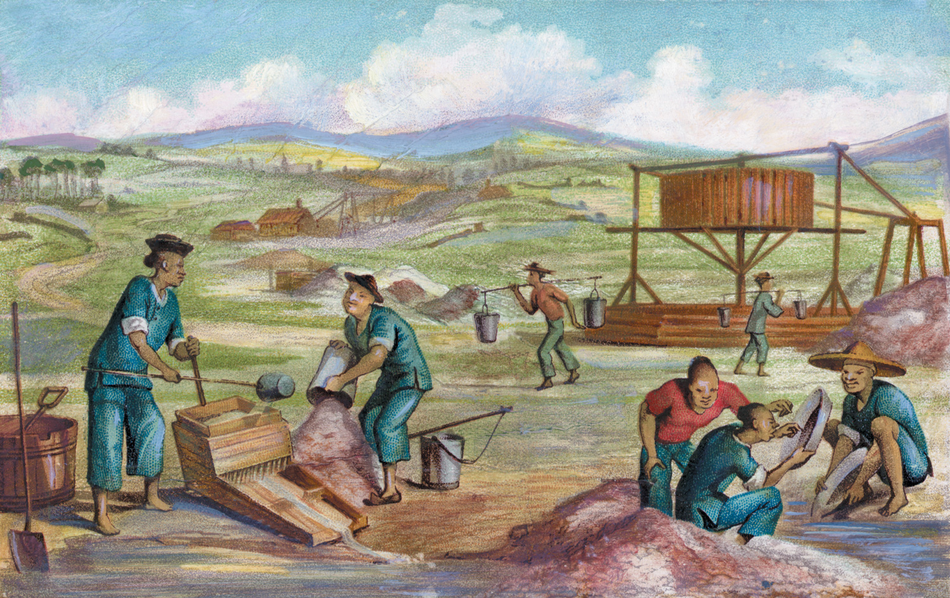
The Chinese

Slide 19
16.9 The Chinese
Reasons they moved to the West
The Chinese migrated across the Pacific to find gold and riches.
Hardships they faced
Laws taxing foreign miners drove these Chinese out of the gold camps.
Chinese immigrants suffered persecution by Americans.
Legacies they left
The Chinese helped develop agriculture in California.
They brought their culture to the West.

