Slide 1
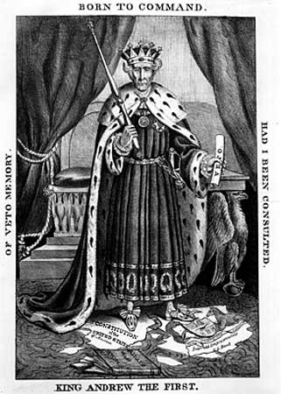
Andrew Jackson & the Growth of American Democracy

Slide 2
14.1 Introduction
John Quincy Adams vs. Andrew Jackson
“mudslinging”
views of rich & well-born, commoners, Native Americans, & states’ rights supporters

Slide 3
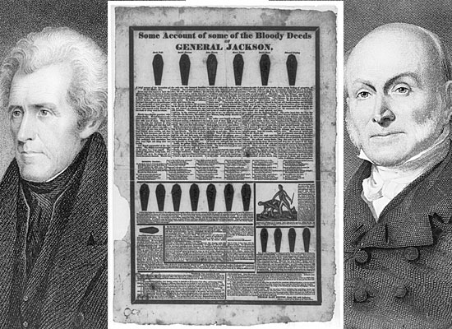

Slide 4
14.2 The Inauguration of Jackson
During the election of 1828 the United States experienced a growth in democracy.
new states pushing for more rights
Prior to this election only white property owners could vote—education & experience to vote wisely
This was first U.S. election where the common people could vote.
over 1 million (3x 1824)
10,000 came to inauguration

Slide 5
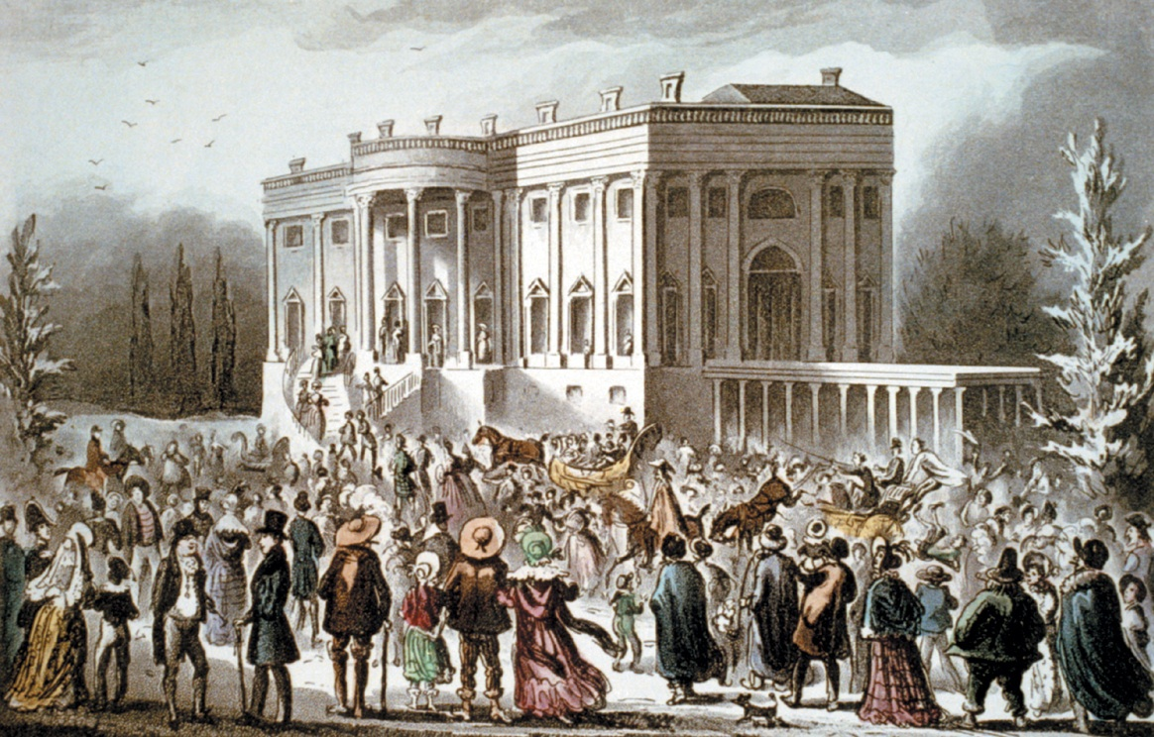

Slide 6
14.2 The Inauguration of Jackson
He was believed to be the champion of the common people & many thought he would reduce the power of moneyed interests.
The elite (Rich & Well Born) were not sure that Jackson would be the best person for the presidency.

Slide 7
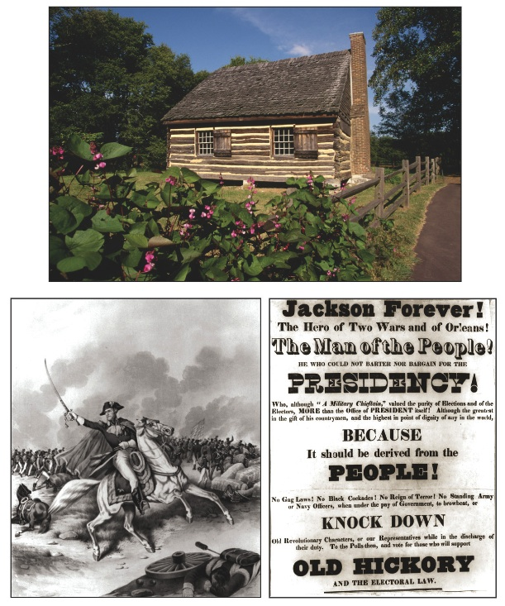

Slide 8
14.3 From the Frontier to the White House
Jackson grew up in poverty.
Jackson was a self made man: lawyer, planter, military hero, and eventually the 7th president of the United States.
Jackson was known for his victory in the Battle of New Orleans.

Slide 9
REPUBLICAN PARTY SPLITS
REPUBLICAN PARTY
DEMOCRATIC PARTY REPUBLICAN PARTY
Reps: farmers, poor, & workers Reps: Rich & Well Born
It is important to note that since the Federalist Party died out during the War of 1812, they took over the Republican Party.

Slide 10
14.3 From the Frontier to the White House
Jackson lost the election of 1824 in the “corrupt bargain” when Clay was accused of trading his support for Adams for a job as Sec. of State.
Jackson supporters founded a new Democratic Party to represent the common people.

Slide 11
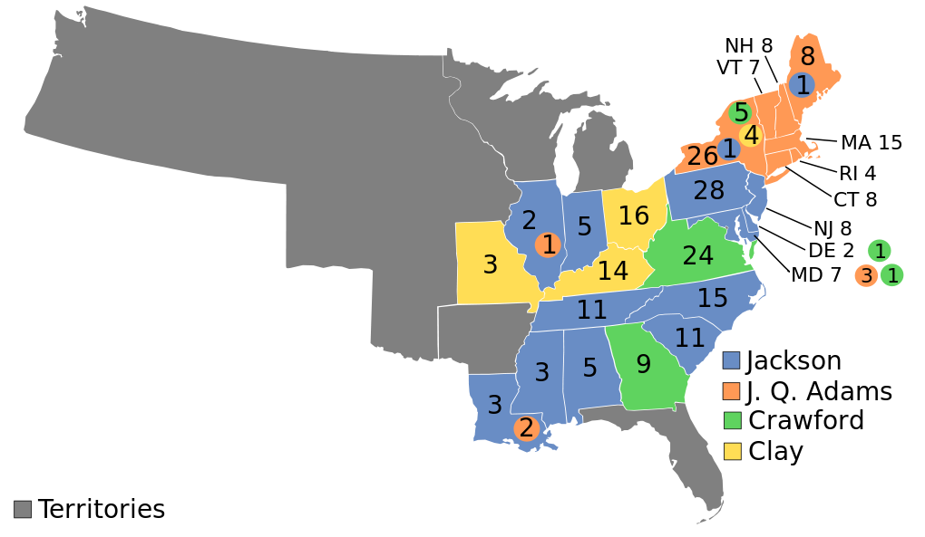
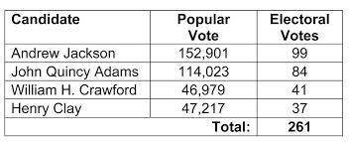

Slide 12
14.4 Jacksons Approach to Governing
Jackson’s approach to governing was controversial.
Jackson relied more on his friends, the kitchen cabinet, than he did on the regular cabinet.
Jackson tried to change/reform the government. He believed that government workers should “go back to making a living as other people do.”

Slide 13
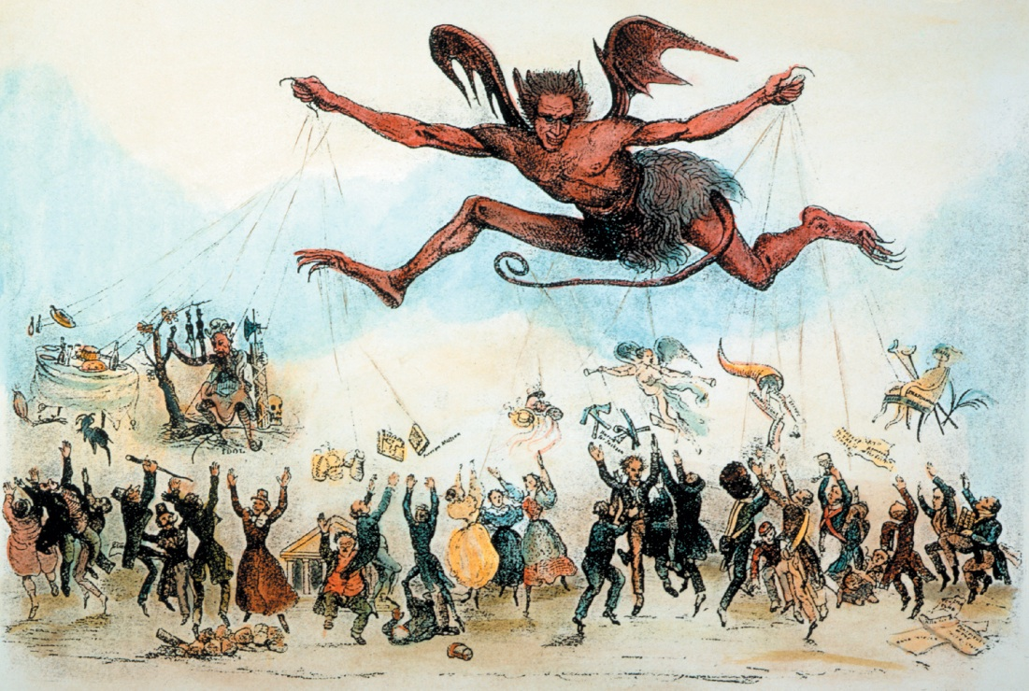

Slide 14
14.4 Jacksons Approach to Governing
Jackson replaced about 10% of civil servants.
Jackson rewarded his followers in the Democratic party with government jobs.
Jackson’s opponents called this the “spoils system,” from the saying “to the victor belong the spoils (rewards) of war.”

Slide 15
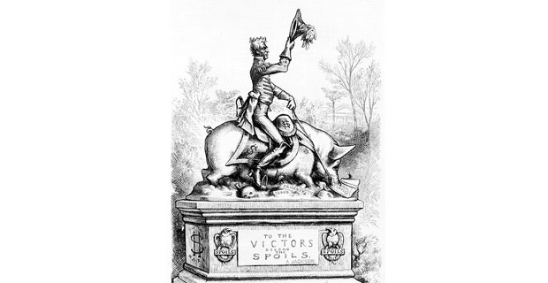

Slide 16
14.5 The Nullification Crisis
Tariffs were a source of unhappiness and hardship in some states, and a source of joy in other states.
Southern states suffered, because of tariffs.
South imported many goods from Europe.
Citizens of South Carolina were outraged in 1828, when a high tariff was passed because they traded their goods w/ foreign countries.

Slide 17
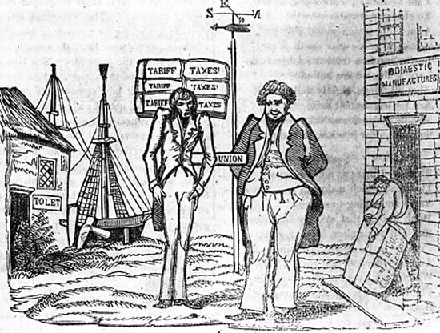

Slide 18
14.5 The Nullification Crisis
South Carolina believed the Fed. Govt. went too far and threatened to secede from the U.S.
John C. Calhoun supported state’s rights and tried to have the tariffs nullified (rejected/canceled) by the state of S. Carolina.
Jackson threatened to send in federal troops, and the crisis ended.

Slide 19
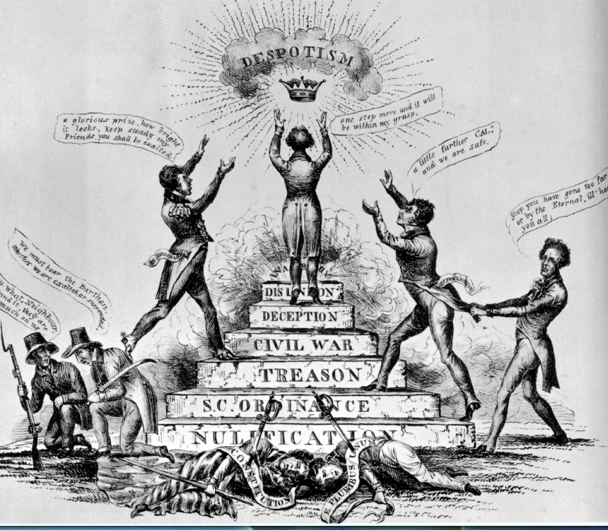

Slide 20
A Question for my Lovely Students
Name another event where a President had to send in troops to prove a point to U.S. citizens, who wanted to rebel against the U.S. government. Who was the President?

Slide 21
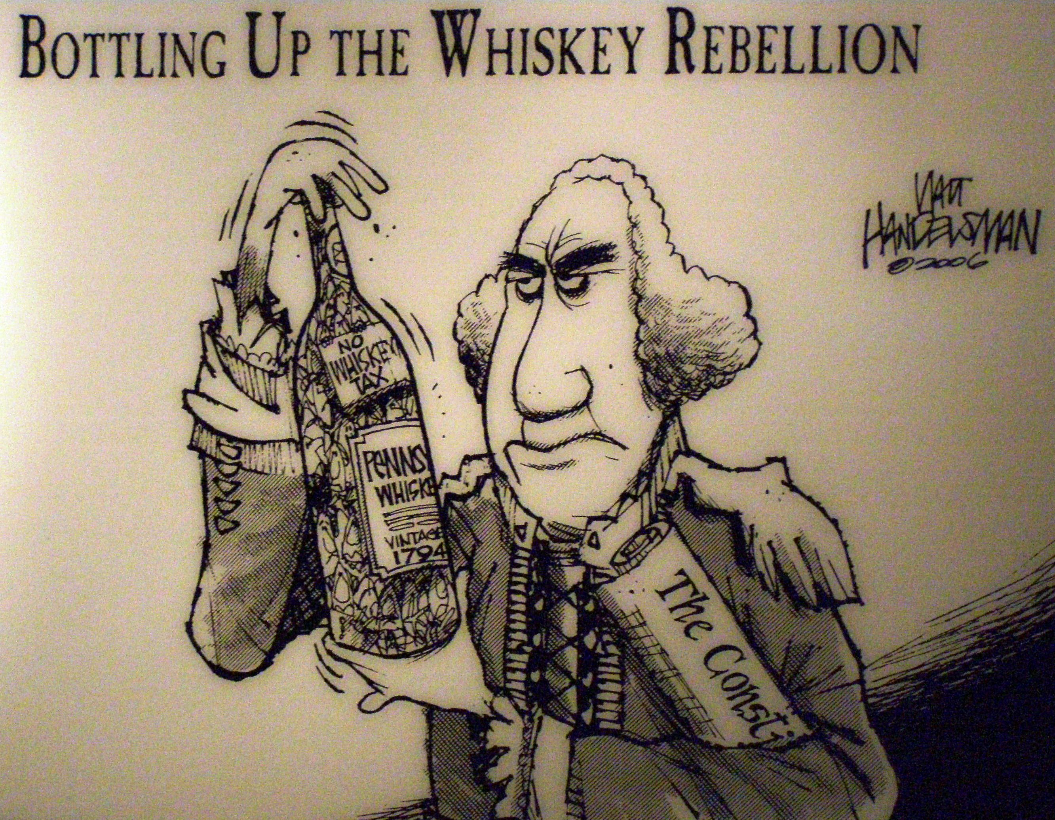
Answer:
The Whiskey Rebellion & President George Washington.

Slide 22
14.6 Jackson Battles the Bank of the U.S.
The Bank of the United States was a controversial institution.
Jackson believed that the Bank served only the rich.
The Bank’s director, Nicholas Biddle, represented everything that Jackson hated, he was rich & well born.

Slide 23
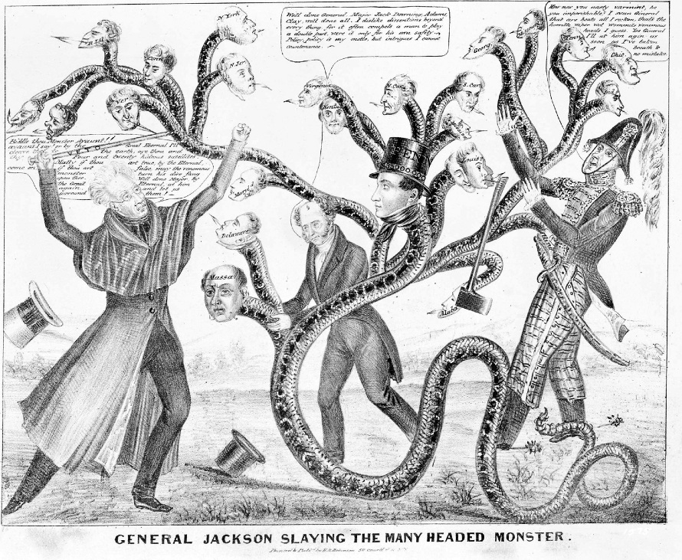

Slide 24
14.6 Jackson Battles the Bank of the U.S.
The government had large deposits in the Bank.
Henry Clay, Jackson’s chief political opponent, tried to use the Bank controversy to defeat Jackson in the 1832 election.
However, Jackson had the support of poor farmers, which helped him to defeat Clay and kill the Bank.
starved it by removing federal deposits & putting in state banks…”pet banks”

Slide 25
14.7 Jackson’s Indian Policy
Jackson believed that Natives should move west to make room for white settlers.
Jackson urged Congress to pass the Indian Removal Act of 1830.
Even Native Americans like the Cherokees-who adopted white ways, passed a constitution, and learned to read & write-were forced west.
“Five Civilized Tribes” = Creek, Cherokee, Choctaw, Chickasaw & Seminole

Slide 26
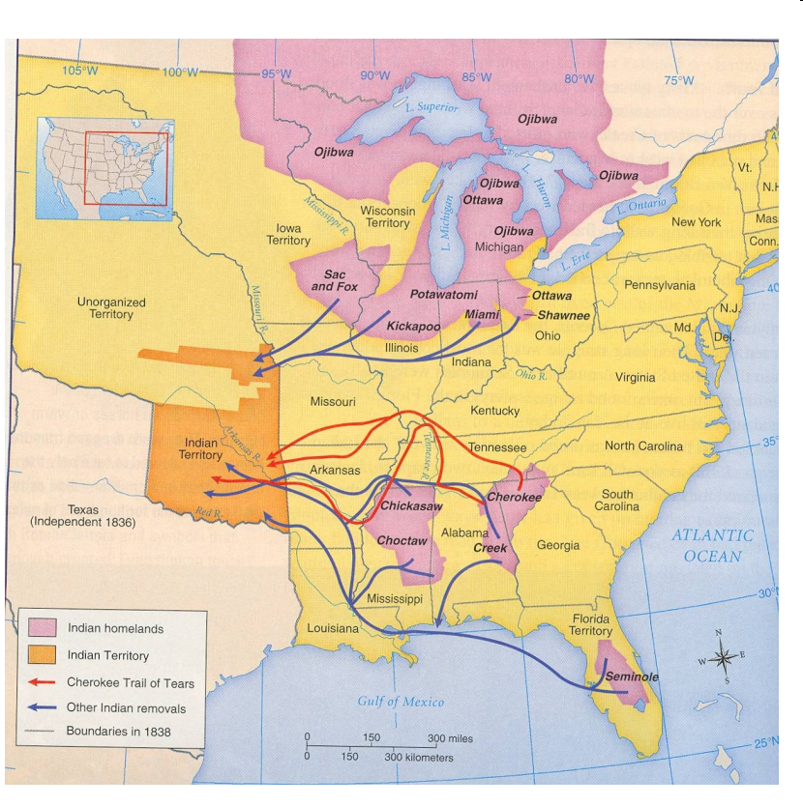

Slide 27
14.7 Jackson’s Indian Policy
Some Native groups, like those led by chief Black Hawk in Illinois, resisted with weapons.
However, their resistance did not work and they were forced to march in the Trail of Tears to new Indian Territory. Many Natives died during their travels.
Supreme Court ruled natives had a right to land, but Jackson met resistance with force
The natives of Florida (known as the Seminoles) were the only group that were successful at resisting removal, because they had the help of runaway slaves & terrain.

Slide 28
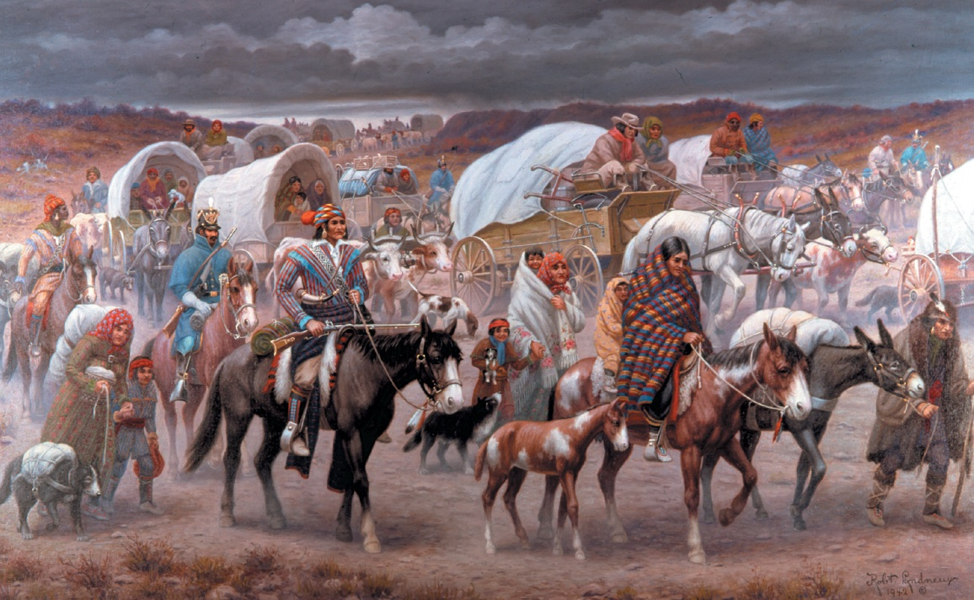

Slide 29
