Slide 1
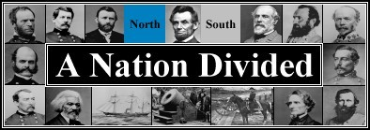
THE AMERICAN CIVIL WAR
1861-1865

Slide 2
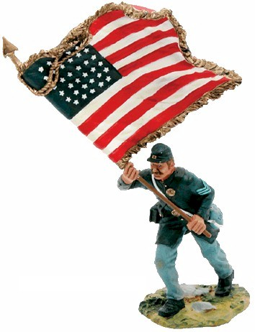
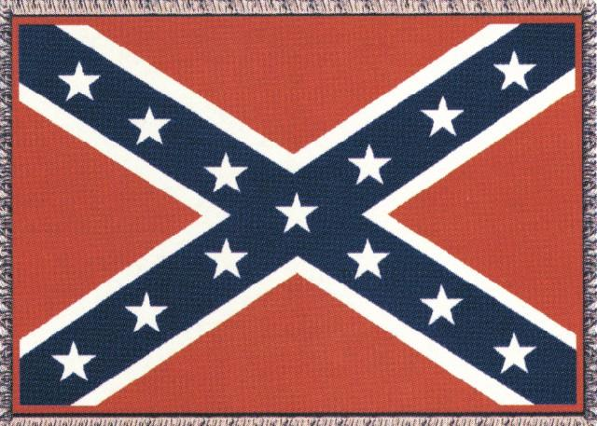
The Civil War: Union vs Confederacy

Slide 3
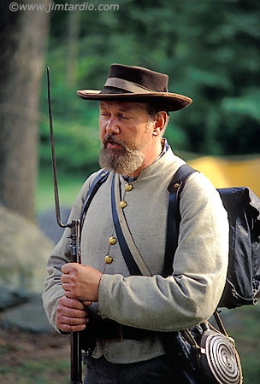
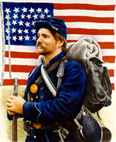
Confederate Union

Slide 4
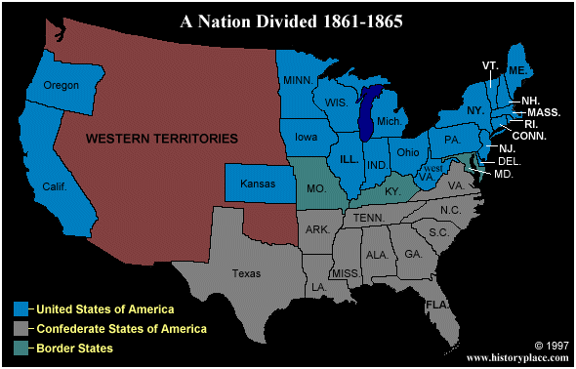
The first States secede

Slide 5
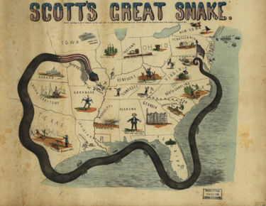
Advantages of the Union (North)?
- population - 22 million
- 90% of ind. goods, esp. munitions
- efficient railroad system
- controlled the navy, which could be used to blockade s. ports and shut down the s. eco.
- but would have to fight an offensive war (long supply lines, unfamiliar territory...)
- capable mil. leaders, inc. Ulysses S. Grant

Slide 6
Confederate (Rebel) advantages (South) and disadvantages
Confederates had excellent generals too -Robert E. Lee and Thomas Jackson
Defending is always easier than attacking - (familiar w/climate and territory, possible psychological advantages)
Farmers fight better than factory workers
Profitable eco. based on cotton exports
But disadvantages…a smaller pop. of 9 million (inc. 3.5 million slaves)
had to import ind. goods; very
little munitions production

Slide 7
GREAT BRITAIN…
The S. was looking for an add. adv., namely an alliance w/ GB (since GB industry was dependent on "King Cotton")...but GB was wary of events and did not want to become involved:
  GB had stockpiled cotton as the conflict was escalating; they had also found other sources (Madras, India)
  most Br. workers who lost their jobs in cotton factories had been able to find work in the new munitions factories that were mostly supplying the N.
  most Br. citizens resented slavery
  Br. crop failures had led to increased grain trade w/ the N.

Slide 8
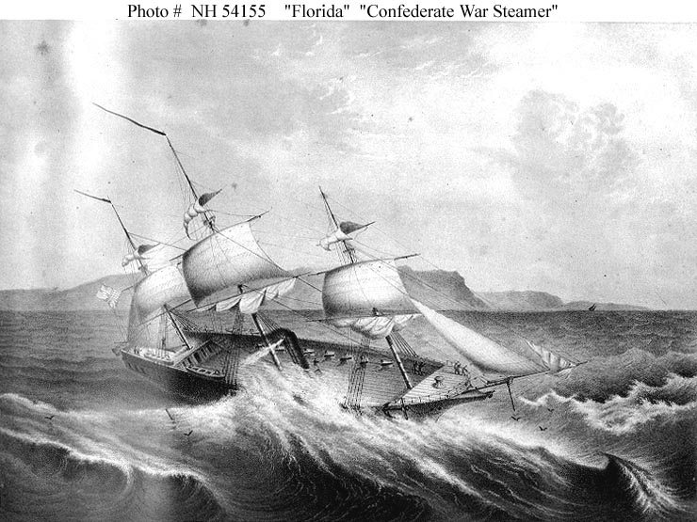
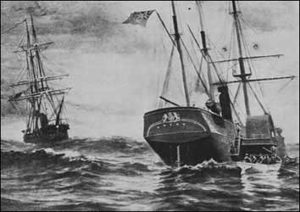
Tensions b/n the N. and GB:
A Br. ship. the Trent, was intercepted by the N. on its way to GB from the S.; it was carrying S. "ambassadors"...the N. resented Br. interference, leading some to call for war; Lincoln simply defused the situation by releasing the ship and the southern "agents"
GB had also sold several ships to the S., namely the Florida and the Alabama - they had sunk many n. ships

Slide 9
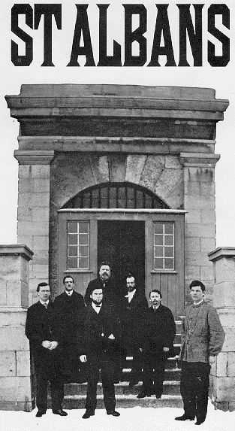
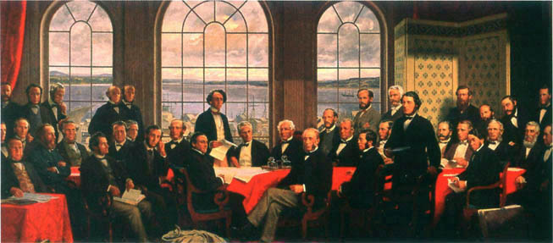
A few southerners had managed to get into BNA, from which they launched several raids into the N.; this inc. a # of bank robberies in Vt. (the best known was the St. Alban's Raid)...some Northerners wanted to invade BNA as punishment
this forced the BNA colonies to begin to consider a Confederation to protect themselves against the US...by 1867, GB agreed w/ the Canadian "Fathers of Confederation" (Canada had become an expensive hassle for the Br…)

Slide 10
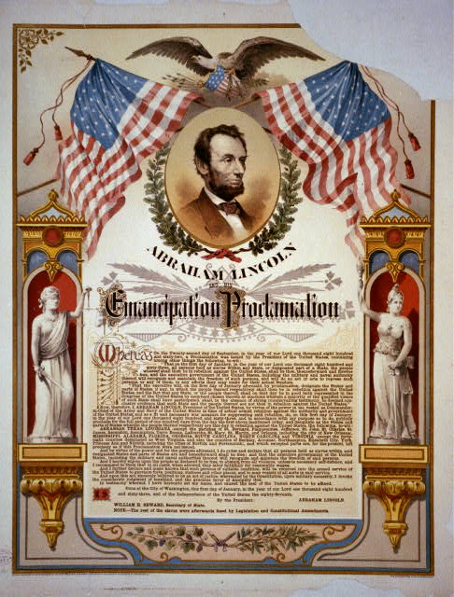
Emancipation Proclamation
It freed the slaves only in states that have seceded from the Union.
It did not free slaves in border states.

Slide 11
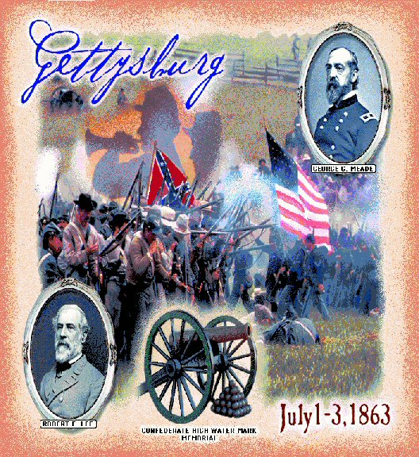

Slide 12
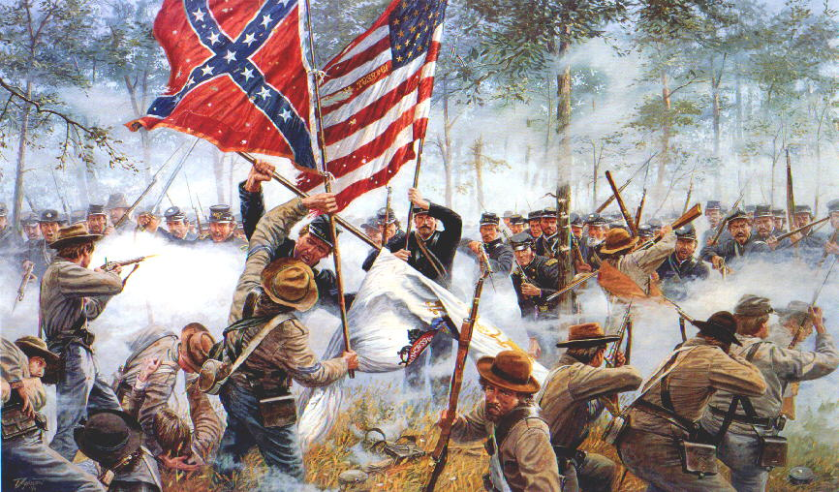
Gettysburg – turning point
Lee realized that the South was in dire straits and decided that it was crucial to attack the North on its own territory
July 1-3, 1863 - BATTLE OF GETTYSBURG, Pa.
Confed. bombardment; Union held firm
on July 3, General Pickett led 15,000 Confed. Troops across open fields - Union mowed them down (= "Pickett’s Charge")
Lee was defeated and retreated to Virgnia
Gettysburg is the largest battle in the history of the Western hemisphere.
Over 100, 000 people died in 3 days →It was the last time the South invaded the North.

Slide 13
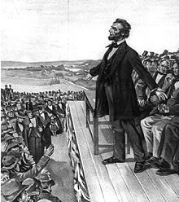
Gettysburg Address
that from these honored dead we take increased devotion to that cause for which they gave the last full measure of devotion -- that we here highly resolve that these dead shall not have died in vain -- that this nation, under God, shall have a new birth of freedom -- and that government of the people, by the people, for the people, shall not perish from the earth.
        Abe Lincoln

Slide 14
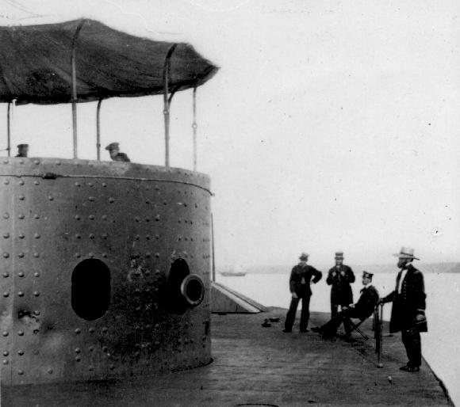
Technology made Civil War . . .
The Monitor

Slide 15
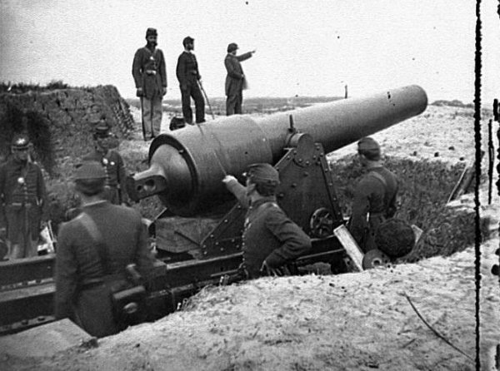
More efficient and deadly

Slide 16
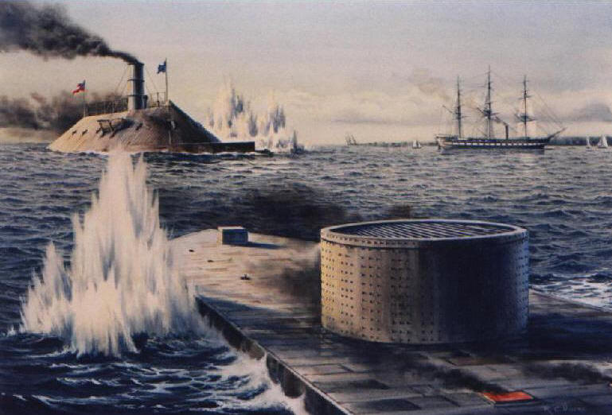
First metal ships in world!

Slide 17
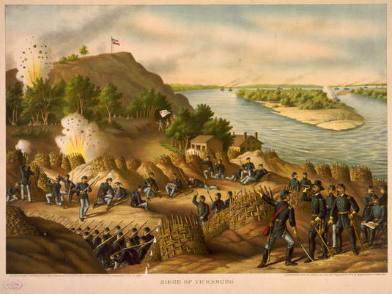
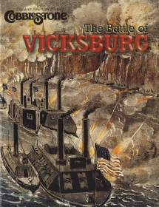
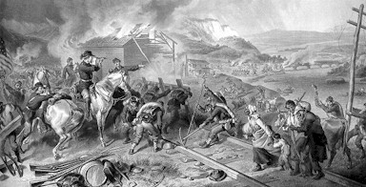

Slide 18
Vicksburg
July 4, 1863 - another Union victory - VICKSBURG
won by U.S. Grant, cut South in 1/2 and gave the Union control of Mississippi River
Grant was then given control of all Union armies → began a "scorched earth" policy to defeat the South
General Sheridan decimated Va.'s Shenandoah Valley
General Sherman given task of taking Atlanta; his "March through Georgia" saw total destruction from Atlanta to Savannah

Slide 19
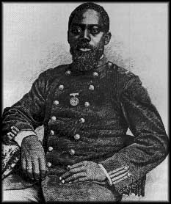
Blacks in the Military
After the Emancipation Proclamation blacks began to join the Union Army
Initially they were only used for manual labor
Eventually, Blacks saw live combat
54th regiment out of Massachusetts
William Carney

Slide 20
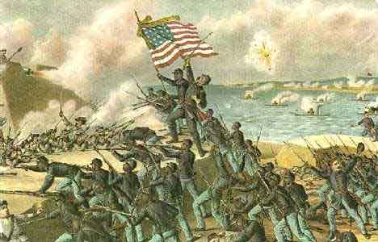
The 54th Regiment attack on Fort Wagner, SC- July 18, 1863

Slide 21
Surrender
April 3, 1865 - Grant took Richmond Va. - final blow to Lee's army
Lee surrenders on April 9, 1865 at APPOMATTOX COURTHOUSE
All Confed. troops forced to take an oath of loyalty to U.S.
otherwise, terms of surrender were lenient
Lincoln didn't want a humiliated South and further conflict
issue of states' rights now "solved"- fed. gov't had asserted its status

Slide 22
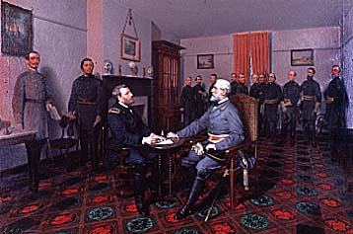

Slide 23
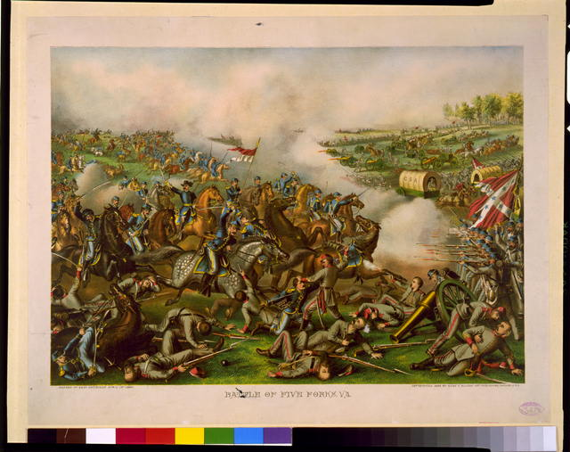
After four bloody years of civil war,
the South was defeated.
Notes:
On slide: Graphic.
Click 1: After four bloody years…
Click to next slide.

Slide 24
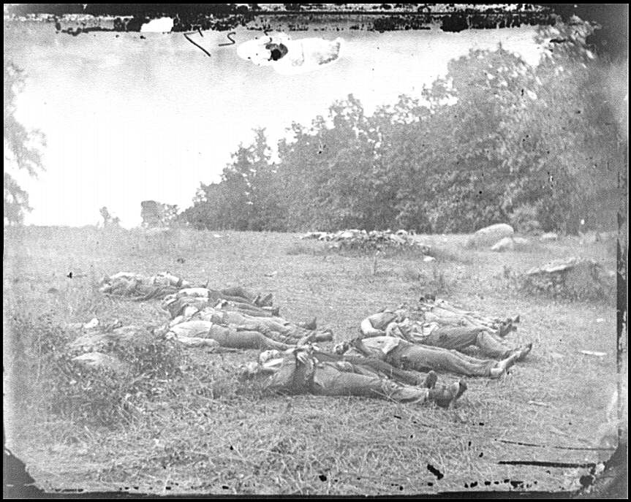
Over 618,000 military deaths during Civil War.

Slide 25
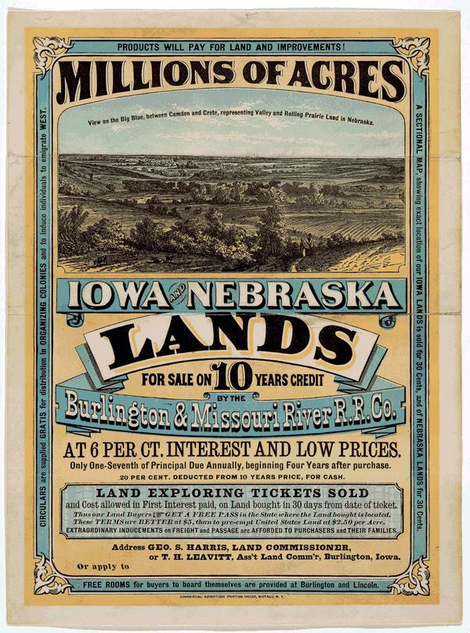

POLITICAL / ECONOMIC DEVELOPMENTS
w/o Southerners in fed. gov't, many changes occurred that benefited the North:
1) Homestead Act passed by Congress in 1862 - encouraged W. expansion w/o slavery
- 165 acres given to anyone who would farm it 5 yrs.
2) Union-Pacific Railway was authorized - great trade potential, focused on the Northern States.
3) Tariffs were put in place to protect Northern industry

Slide 26
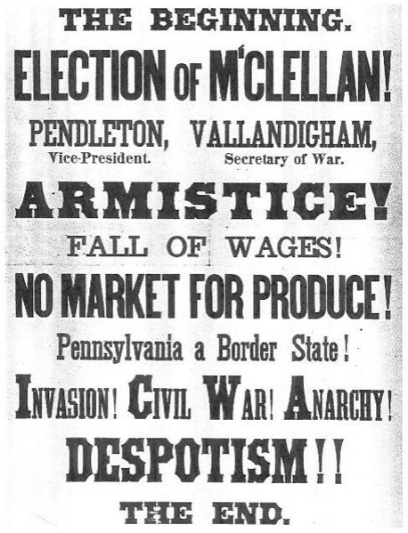
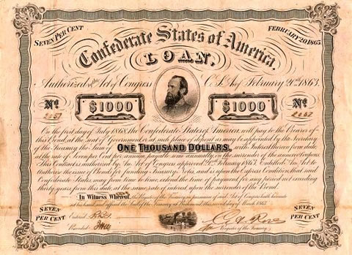
4) Congress established a single federal currency - same value in all states - known as "Greenbacks"
5) to cover war debts, Union gov't issued war bonds and intro'd income tax
6) in a further illustration of fed. gov't power, Lincoln's gov't restricted civil liberties so nothing would detract from Union war effort (suspended Habeas Corpus)
- free press/ speech also interrupted
7) 1864 Election - only in Union
- pitted Republican Lincoln against Democrat General McClellan → Lincoln won easily, assuring that war will continue (N. Democrats wanted an end)

Slide 27
EFFECTS OF CIVIL WAR
creation of a single unified country
abolition of slavery
increased power to fed. gov't – killed the issue of states rights
U.S. now an industrial nation
a stronger sense of nationalism
w. lands increasingly opened to settlement
South was economically and physically devastated, w/ the plantation system crippled...thus Reconstruction (rebuilding the U.S.) - but a deep hatred of the North remained...

